Slide 1

End-to-End Testing Tools
Demo on how to use Cypress and Cucumber to test front-end and back-end code.
Lakshi Villavarayen,
Senior Quality Engineer
Manale Henini,
Software Engineer I

Slide 2
Why test?
Thorough testing is necessary to discover bugs/defects that need to be resolved prior to delivery to client. This ensures the dependability, security, and quality of the software.

Slide 3
CYPRESS

Slide 4
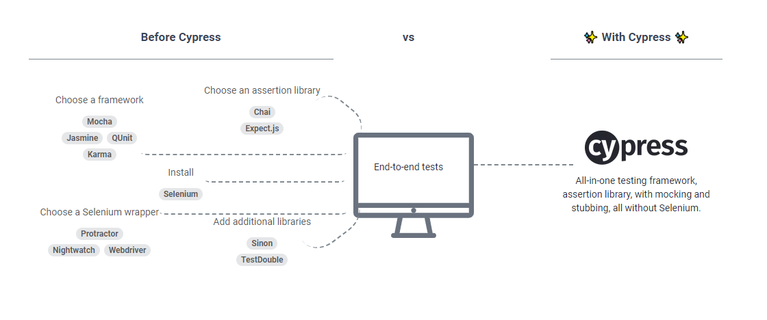
What’s Cypress?
A complete-end-to-end testing experience

Slide 5




Why Cypress?
Works on any front-end framework or website.
For Developers and QA Engineers.
Supports Time Travel and Real Time Reloads.
Cypress runs much, much faster.
With Cypress it’s possible to:
Set up tests Write tests Run tests Debug tests

Slide 6
Getting Set Up.
Install Node (version 14)
Install Cypress
Install the cypress-realworld-app

Slide 7
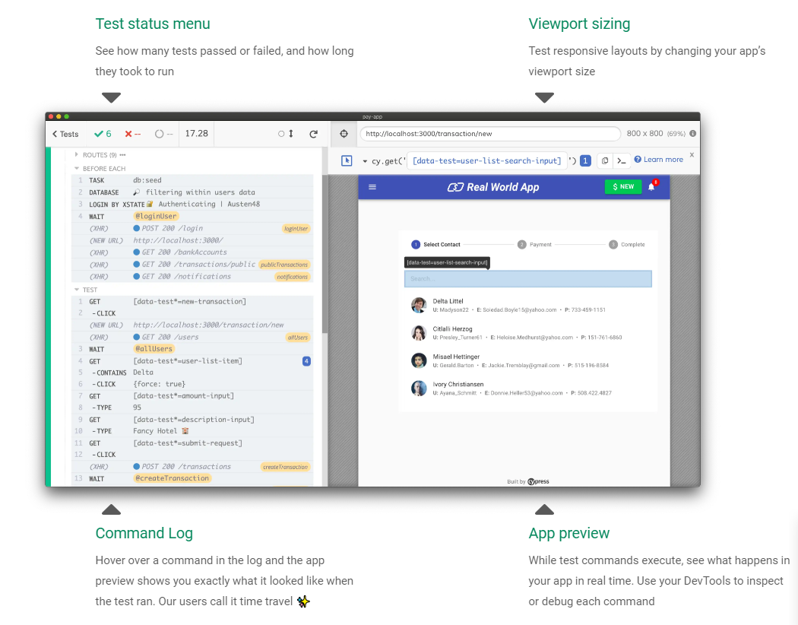

Slide 8

Cypress Resources
For more info on how Cypress works, including documentation and tutorials, please visit https://www.cypress.io/
For instructions on installing the Real World App please visit https://github.com/cypress-io/cypress-realworld-app

Slide 9
CUCUMBER

Slide 10
First, Behavior-Driven Development
Also known as BDD
An agile software development process
Focuses on expected behavior
Encourages collaboration across whole team
Goal: agree on a how an application should behave based on concrete examples.

Slide 11
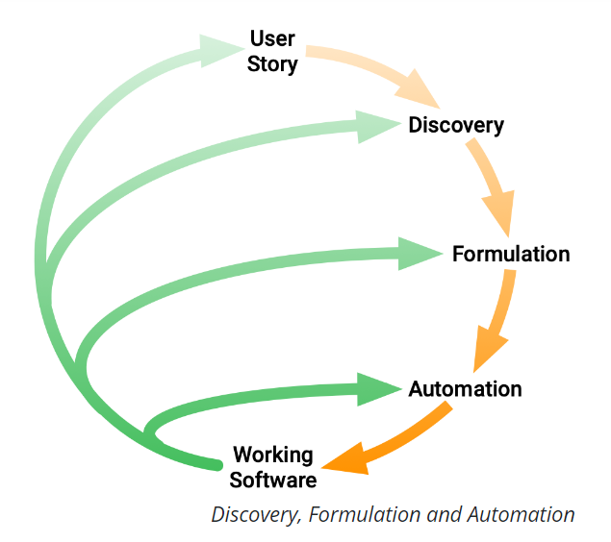



BDD Process
This is a placeholder image. Select the imag, delete it and click on the icon to insert your new image.
Discovery
What it could do: Agree on concrete examples from User Story.
Formulation
What it should do: Document the examples.
Automation
What it actually does: Implement the documented behavior.

Slide 12
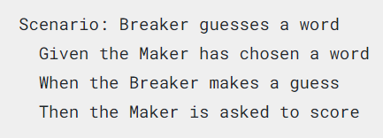
Now, What’s Cucumber?
Cucumber is a tool that supports the BDD process.
Reads plain text specifications and verifies software follows them.
Specifications are made of examples, or scenarios, ex:
Scenarios are made of steps.

Slide 13
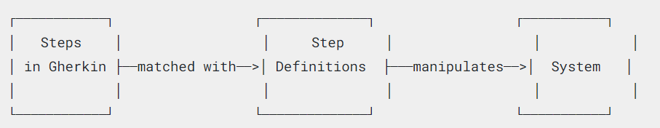
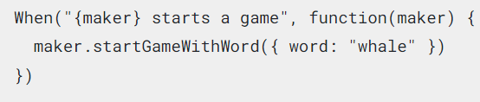
Cucumber Scenarios
Scenarios have 2 parts: Gherkin syntax and Step Definitions
What’s Gherkin?
A set of grammar rules to give plain text structure
Gherkin documents are stored in .feature text files
What are Step Definitions?
Connect Gherkin steps to programming code
Can be written in many programming languages. JavaScript example:

Slide 14


Cucumber Resources
For more info on how Cucumber works, including documentation and tutorials, please visit https://cucumber.io/
To access the complete code for the cucumber tutorial and these slides please visit https://github.com/mhenini/CucumberDemo Or scan

Slide 15


